Slide 1


Enhanced Attribute-Based Explanations of Multidimensional Projections
D. van Driel¹, X. Zhai¹, Z. Tian², A. Telea²
¹ University of Groningen, the Netherlands
² Utrecht University, the Netherlands

Slide 2











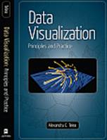

















Introduction
Who am I?
PhD in scientific visualization (TU Eindhoven, 2000)
assistant professor in visualization (TU Eindhoven, 2000-2007)
professor in multiscale visual analytics (RUG, 2007-2019)
professor in visual data analytics (UU, since 2019)
28 PhD students, 70+ MSc students
research: visual analytics, shape analytics, machine learning
http://www.staff.science.uu.nl/~telea001
www.solidsourceit.com
Data Visualization: Principles and Practice A. K. Peters, 2008 / 2014

Slide 3
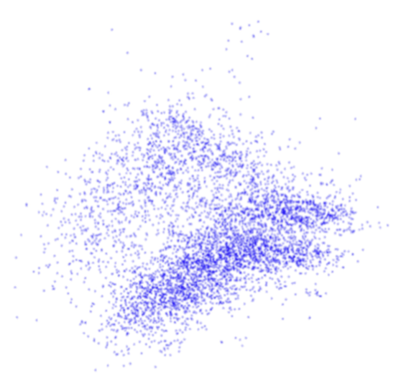
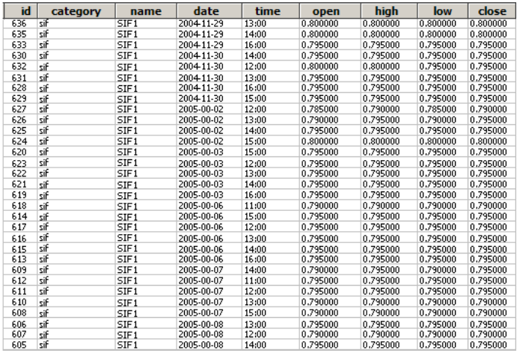
Multidimensional Projections
Data table
2D projection
a table row gets mapped to a point
2D point distance reflects
nD row similarity
How to explain the visual structures
that we see in the projection?

Slide 4
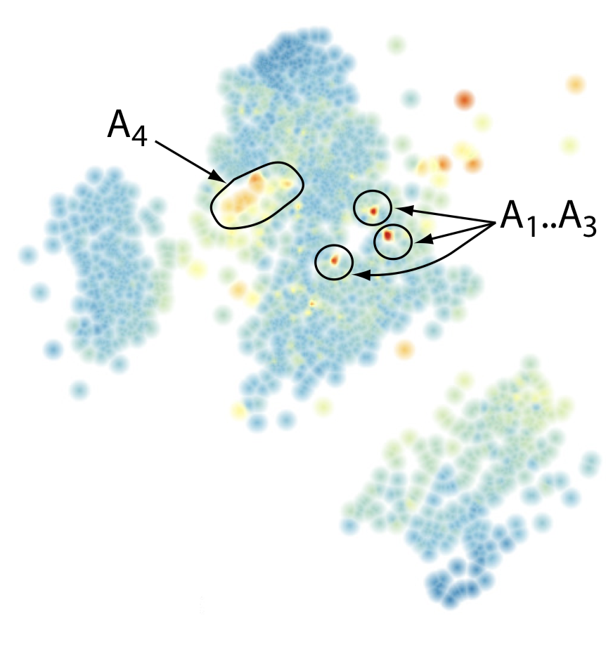
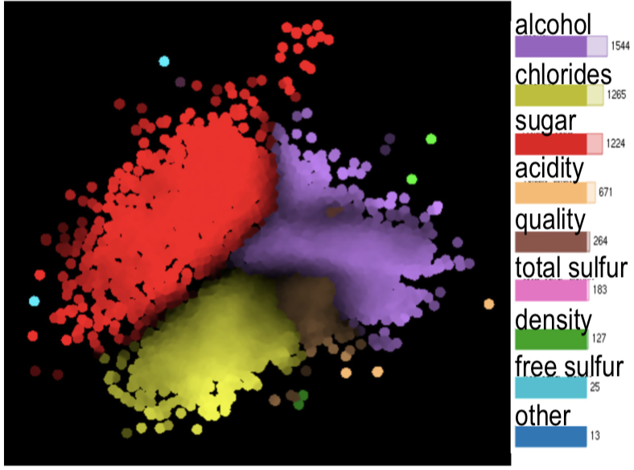
Projection Explanations
color-code one dimension
show false neighbors
show missing neighbors
explain x and y axes
explain neighborhoods

Slide 5
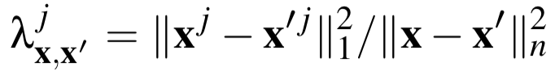
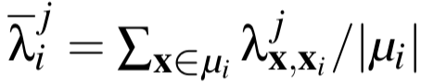
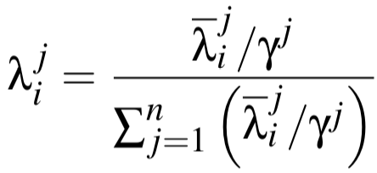
Attribute-Based Explanation
Contribution of j ^{th} dimension to distance
between data points x and x’
Contribution of j ^{th} dimension
to a neighborhood μ_{i}
Normalized contribution of
j ^{th} dimension to a neighborhood μ_{i}
color: C dimensions having overall low λ_{i} over all i
R. Da Silva et al. (2015) Attribute-based Visual Explanation of Multidimensional Projections. Proc. EuroVA
Notes:
If l_i^j is low, dimension j contributes LITTLE to distances in nbhood around point i, so explains WELL why points there are similar

Slide 6
Attribute-Based Explanation
Points explained well by
dimension X
Points explained well by
dimension Z
Brightness shows explanation confidence
Dark areas: cannot explain points here by a single dimension
Points explained well by
dimension Y

Slide 7
Extension 1: Dimensionality Explanation
“How high-dimensional is the data at this place in the projection?”
Find local dimensionality δ of each neighborhood μ_{i} using PCA
Total variance: δ = minimal # of eigenvalues α₁ ≥ … ≥ α_{δ} needed to capture θ% of data variance in μ_{i}
Minimal variance: δ = # of eigenvalues α_{i} larger than a user-set minimal variance θ
attribute contribution
total variance
minimal variance
Notes:
Total variance and minimal variance give very similar results
Edges of cube: data is there inherently 3D. Faces of cube: Data is there inherently 2D

Slide 8
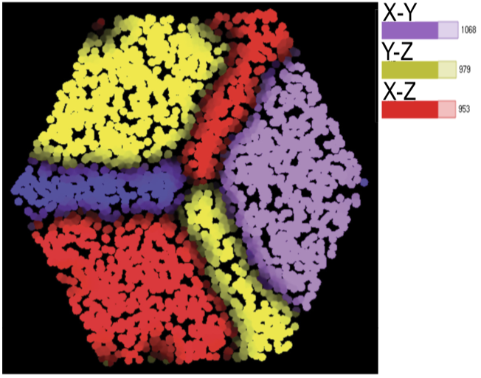
Extension 2: Correlation Explanation
“Which attributes are strongest correlated here in the projection?”
Compute Pearson correlations of all attribute-pairs over each neighborhood μ_{i}
Show (by color coding) C top-ranked pairs that are most frequent over all μ_{i}
X changes little here…
...and Y, Z strongly correlated
attribute contribution
correlation view
Notes:
The different views help each other in explaining the data

Slide 9
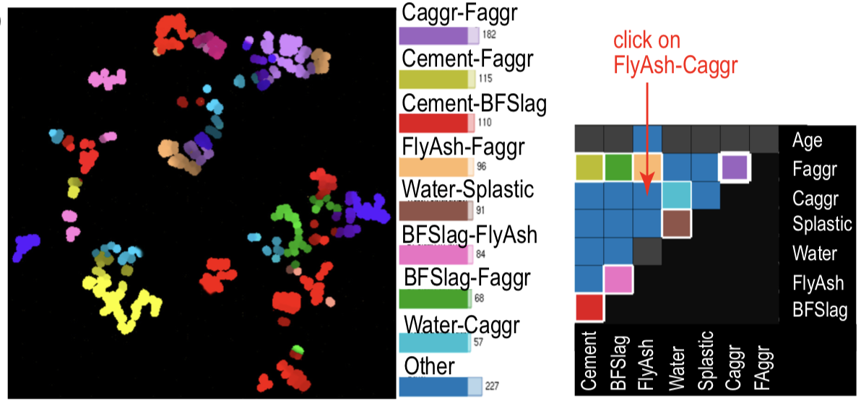
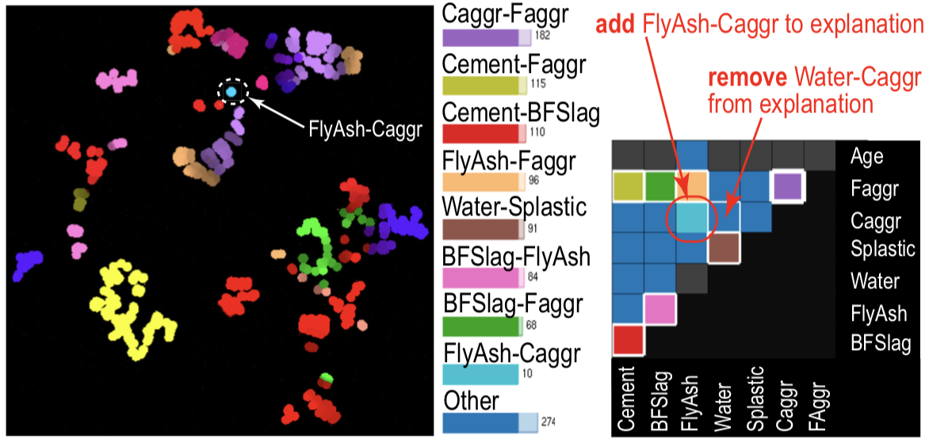
Correlation Explanation: Examining specific dimensions
Cement dataset (1030 samples, 8 dimensions)
Initial view: Where is FlyAsh correlated with Caggr
(if anywhere)?
We discover a small neighborhood where these two dimensions strongly correlate
matrix showing C=8
most important of all
32 correlations
Notes:
For n dimensions, we have n^2/2 possible correlations. Color-coding only shows the C (<=10) most important ones. What to do when we have many dimensions, or want to examine specific correlations?
Take the left view, showing the strongest and most frequent correlations over all neighborhoods. The matrix view shows these correlations (color coded for C=8 variable-pairs). Blue cells indicate variable-pairs which are either weakly correlated or strongly correlated but over fewer points than the top 8 ones. We are e.g. interested to see where (if anywhere) are FlyAsh and Caggr correlated. We click in that cell of the matrix view.
Then, the color allocated to the last of the top-8 variable pairs (light blue, used for Water-Caggr) is removed from the matrix view, and allocated to show points where FlyAsh and Caggr are strongly correlated. See the right images: We discover a small, dense, neighborhood of points where this happens.

Slide 10
Example use-case
Wine dataset (6497 samples, 12 attributes)
Raw projection (with LAMP) Pretty uninformative

Slide 11
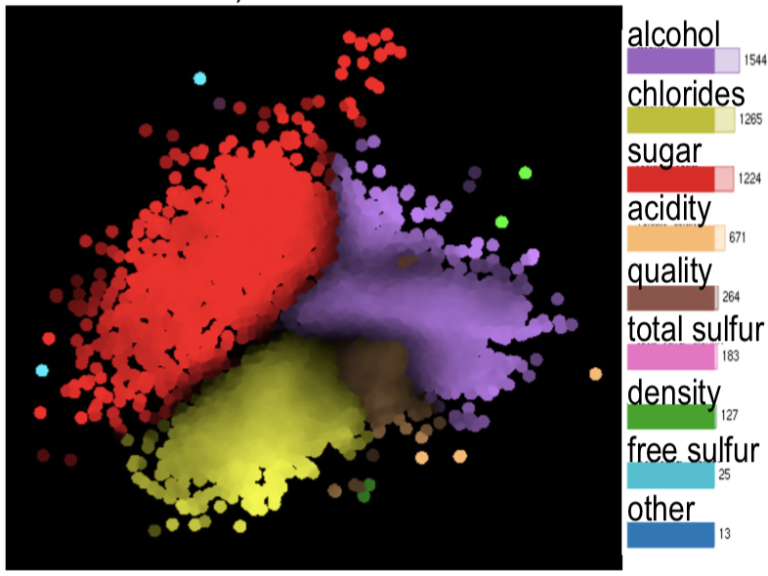
Example use-case
All wines here have similar sugar percentages
Wine dataset (6497 samples, 12 attributes)
Raw projection (with LAMP) Pretty uninformative
Attribute contribution
Data gets split into clusters having
good single-attribute explanations

Slide 12
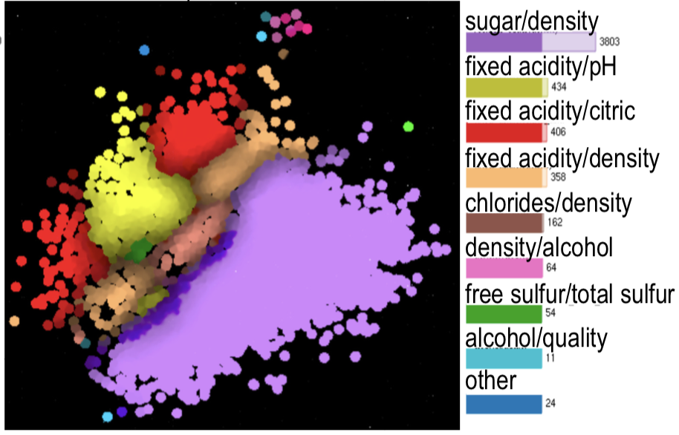
Example use-case: Combining views
All wines here have similar sugar percentages…
…and fixed acidity strongly correlates with pH or citric acid
Attribute contribution
Correlation view
Notes:
If we bring in the correlation view, we see that the red area in the attribute contribution view (left), having wines with similar sugar percentages, also have fixed acidity strongly correlating with pH or citric acid. So, the correlation view REFINES the explanation of the contribution view.

Slide 13
Example use-case: Combining views
Correlation view
Attribute contribution
All wines here have a strong correlation sugar vs density
..and have similar values of alcohol, chlorides, or acidity
Notes:
Refinement also works conversely: The correlation view (left) shows a big area where wines correlate strongly over sugar vs density. The attribute contribution view REFINES this by splitting that area into wines similar due to alcohol, chlorides, or acidity. So, the two views COMPLEMENT each other.

Slide 14
Combining all three views
need 3..5 dimensions
to explain
These 2 views explain jointly by 5 dimensions We have enough explanations here ☺
Dimensionality view
Correlation view
Attribute contribution
need 6..8 dimensions to explain
These 2 views explain jointly by 5 dimensions We need additional explanations here ☹
Notes:
We found several local explanations for the wine dataset using the contribution view and correlation view. Are those explanations SUFFICIENT? The dimensionality view helps answering this. The view (shown left for 85% of explained variance) shows that, top-left, the projection can be explained by roughly 3..5 dimensions. The combined correlation-contribution views give us 5 dimensions that explain this area. So we’re happy here. In contrast, bottom-right, the projection needs 6..8 dimensions to be explained. The combined correlation-contribution views give us, still, only 5 explanatory dimensions in this area. Hence, we need more dimensions to explain well here…

Slide 15
Conclusions
Attribute-based explanation of projections
add dimensionality and correlation to existing contribution explanation
views are effective together
easy to implement, fast to compute
works for any projection method
Future work
higher dimensional data (50..100 dimensions)
capture/show more complex patterns

